Slide 1
R Basics

Slide 2
R Basics
R and RStudio
Data types
Data structures

Slide 3

Open source
Core R and libraries (packages)
Statistics
Analytics
Visualisation
R or Python?
https://www.datacamp.com/community/tutorials/r-or-python-for-data-analysis
R in a nutshell
Notes:
R is a popular programming language used for statistical computing and graphical presentation.
Its most common use is to analyze and visualize data.
Why Use R?
It is a great resource for data analysis, data visualization, data science and machine learning
It provides many statistical techniques (such as statistical tests, classification, clustering and data reduction)
It is easy to draw graphs in R, like pie charts, histograms, box plot, scatter plot, etc++
It works on different platforms (Windows, Mac, Linux)
It is open-source and free
It has a large community support
It has many packages (libraries of functions) that can be used to solve different problems

Slide 4

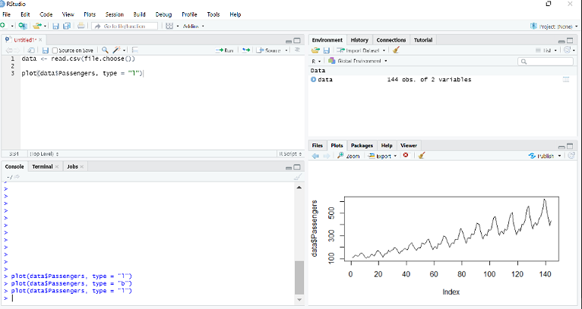
editor
data
RStudio
console
plots

Slide 5
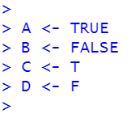
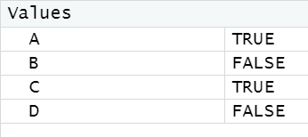

Logical
Numeric
> X <- 3.14
Integer
> Y <- 5L
Character
> S1 <- ‘Hello’
> S2 <- “QA”
Data types in r
IMPORTANT
R is case sensitive
Variable names must not include spaces
Notes:
Variables can store data of different types, and different types can do different things.
In R, variables do not need to be declared with any particular type, and can even change type after they have been set:
Basic data types in R can be divided into the following types:
numeric - (10.5, 55, 787)
integer - (1L, 55L, 100L, where the letter "L" declares this as an integer)
complex - (9 + 3i, where "i" is the imaginary part)
character (a.k.a. string) - ("k", "R is exciting", "FALSE", "11.5")
logical (a.k.a. boolean) - (TRUE or FALSE)
Numeric
A numeric data type is the most common type in R, and contains any number with or without a decimal, like: 10.5, 55, 787:
Example
x <- 10.5 y <- 55 # Print values of x and y x y # Print the class name of x and y class(x) class(y)
Integer
Integers are numeric data without decimals. This is used when you are certain that you will never create a variable that should contain decimals. To create an integer variable, you must use the letter L after the integer value:
Example
x <- 1000L y <- 55L # Print values of x and y x y # Print the class name of x and y class(x) class(y)

Slide 6
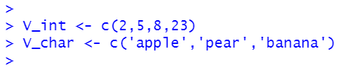
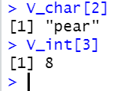
Vector
One-dimensional
Contains data of the same type
Indexes in R start from 1.
Data Structures in R - vector
Notes:
A vector is simply a list of items that are of the same type.
To combine the list of items to a vector, use the c() function and separate the items by a comma.
In the example below, we create a vector variable called fruits, that combine strings:
Example
# Vector of strings fruits <- c("banana", "apple", "orange") # Print fruits fruits
In this example, we create a vector that combines numerical values:
Example
# Vector of numerical values numbers <- c(1, 2, 3) # Print numbers numbers

Slide 7
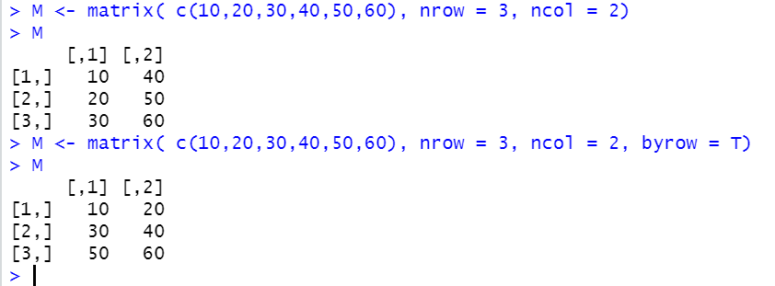
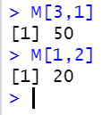
Matrix
Two-dimensional (rows and columns)
Contains data of the same type
The matrix elements have two indices – for row and column:
Data Structures in R - matrix
Notes:
A matrix is a two dimensional data set with columns and rows.
A column is a vertical representation of data, while a row is a horizontal representation of data.
A matrix can be created with the matrix() function. Specify the nrow and ncol parameters to get the amount of rows and columns:
Example
# Create a matrix thismatrix <- matrix(c(1,2,3,4,5,6), nrow = 3, ncol = 2) # Print the matrix thismatrix
You can also create a matrix with strings:
Example
thismatrix <- matrix(c("apple", "banana", "cherry", "orange"), nrow = 2, ncol = 2) thismatrix
Access Matrix Items
You can access the items by using [ ] brackets. The first number "1" in the bracket specifies the row-position, while the second number "2" specifies the column-position:
Example
thismatrix <- matrix(c("apple", "banana", "cherry", "orange"), nrow = 2, ncol = 2) thismatrix[1, 2]

Slide 8
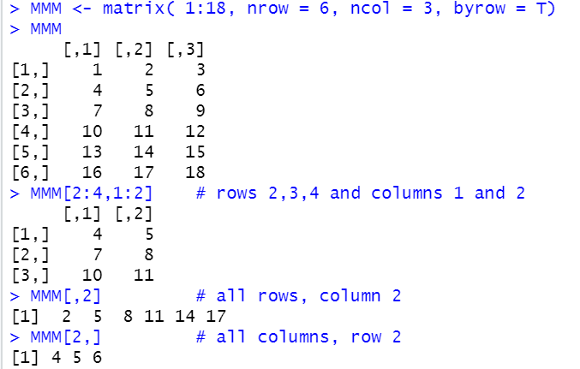
Matrix - slicing
Data Structures in R - matrix

Slide 9
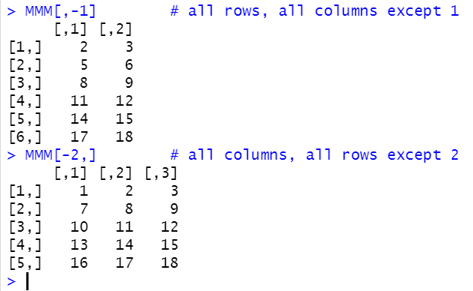
Matrix - slicing
Data Structures in R - matrix

Slide 10
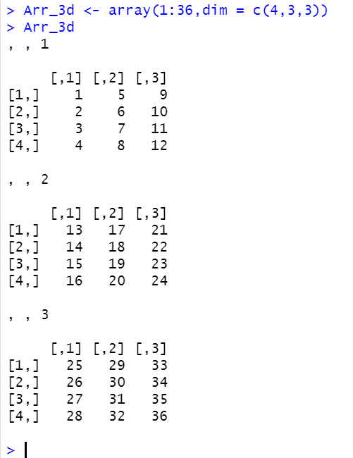
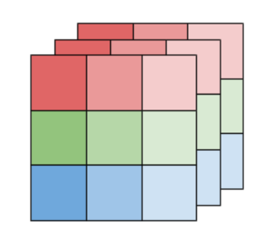
A matrix is a 2-dimensional array.
An array can only hold data of the same type.
There is no logical limit on the number of the dimensions of an array.
Data Structures in R - aRrAy
3-dimensional array
Imagine matrices stacked together
For fans of science fiction and multiple dimensions:
https://en.wikipedia.org/wiki/%22%E2%80%94And_He_Built_a_Crooked_House%E2%80%94%22
Notes:
Compared to matrices, arrays can have more than two dimensions.
We can use the array() function to create an array, and the dim parameter to specify the dimensions:
Example
# An array with one dimension with values ranging from 1 to 24 thisarray <- c(1:24) thisarray # An array with more than one dimension multiarray <- array(thisarray, dim = c(4, 3, 2)) multiarray
Example Explained
In the example above we create an array with the values 1 to 24.
How does dim=c(4,3,2) work? The first and second number in the bracket specifies the amount of rows and columns. The last number in the bracket specifies how many dimensions we want.
Note: Arrays can only have one data type.
Access Array Items
You can access the array elements by referring to the index position. You can use the [] brackets to access the desired elements from an array:
Example
thisarray <- c(1:24) multiarray <- array(thisarray, dim = c(4, 3, 2)) multiarray[2, 3, 2]
The syntax is as follow: array[row position, column position, matrix level]

Slide 11
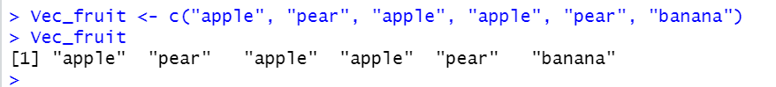
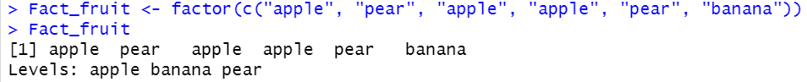
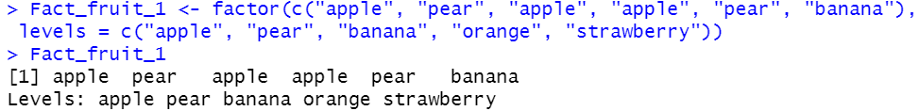
Factors are data structures that store qualitative (categorical) data.
Character vector
Factor
Stores a nominal categorical variable, levels derived from the data.
Factor
Stores a nominal categorical variable, levels predefined.
Data Structures in R - factor
Notes:
Factors
Factors are used to categorize data. Examples of factors are:
Demography: Male/Female
Music: Rock, Pop, Classic, Jazz
Training: Strength, Stamina
To create a factor, use the factor() function and add a vector as argument:
Example
# Create a factor music_genre <- factor(c("Jazz", "Rock", "Classic", "Classic", "Pop", "Jazz", "Rock", "Jazz")) # Print the factor music_genre
Result:
[1] Jazz Rock Classic Classic Pop Jazz Rock Jazz Levels: Classic Jazz Pop Rock
You can see from the example above that that the factor has four levels (categories): Classic, Jazz, Pop and Rock.
To only print the levels, use the levels() function:
Example
music_genre <- factor(c("Jazz", "Rock", "Classic", "Classic", "Pop", "Jazz", "Rock", "Jazz")) levels(music_genre)
Result:
[1] "Classic" "Jazz" "Pop" "Rock"

Slide 12
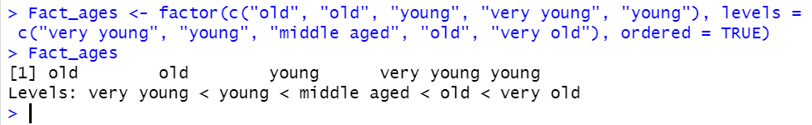
Factors are data structures that store qualitative (categorical) data.
Factor
Stores an ordinal categorical variable, levels predefined.
Data Structures in R - factor

Slide 13
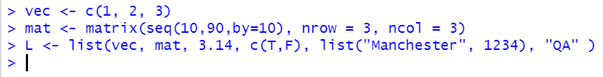
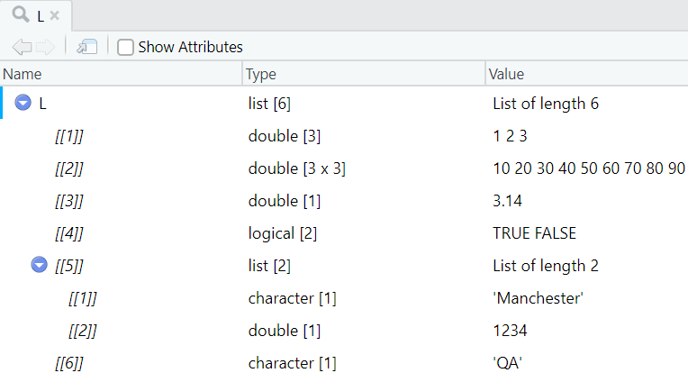
Lists store elements of any structure and data type, including other lists.
Data Structures in R - list
Notes:
A list in R can contain many different data types inside it. A list is a collection of data which is ordered and changeable.
To create a list, use the list() function:
Example
# List of strings thislist <- list("apple", "banana", "cherry") # Print the list thislist
To change the value of a specific item, refer to the index number:
Example
thislist <- list("apple", "banana", "cherry") thislist[1] <- "blackcurrant" # Print the updated list thislist

Slide 14
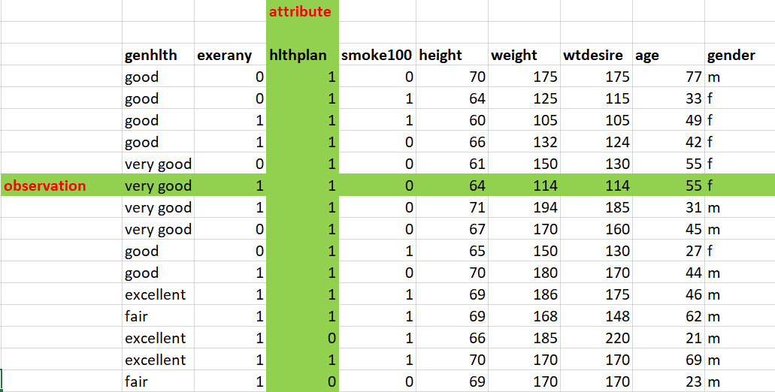
Data Frame
Tabular, 2 dimensional (rows and columns)
Columns can contain data of different types
Data frames are the data structures most suited for analytics:
Data Structures in R – data frame
Notes:
Data Frames are data displayed in a format as a table.
Data Frames can have different types of data inside it. While the first column can be character, the second and third can be numeric or logical. However, each column should have the same type of data.
Use the data.frame() function to create a data frame:
Example
# Create a data frame Data_Frame <- data.frame ( Training = c("Strength", "Stamina", "Other"), Pulse = c(100, 150, 120), Duration = c(60, 30, 45) ) # Print the data frame Data_Frame

Slide 15
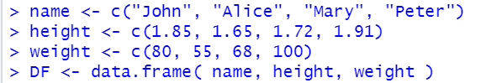
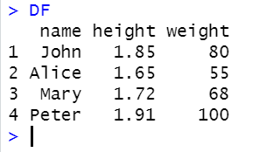
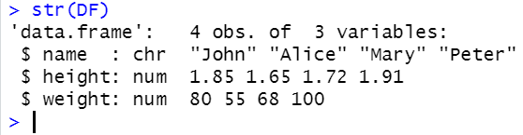
Data frames can be created using data.frame()
Data type of each column:
Data Structures in R – data frame
Notes:
str() – function to print Structure of df

Slide 16
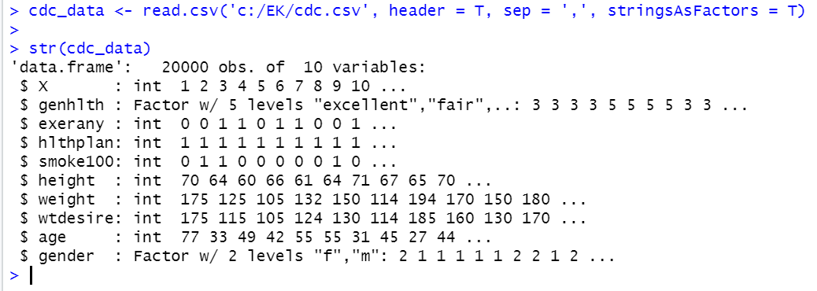
When reading data from a CSV file the result is a data frame:
Data Structures in R – data frame
Notes:
Syntax: read.csv(file, header, sep, dec) Parameters: file: the path to the file containing the data to be imported into R. header: logical value. If TRUE, read.csv() assumes that your file has a header row, so row 1 is the name of each column. If that’s not the case, you can add the argument header = FALSE. sep: the field separator character dec: the character used in the file for decimal points.
By default, when building or importing a data frame, the columns that contain characters (i.e., text) are coerced (=converted) into the factor data type. Depending on what you want to do with the data, you may want to keep these columns as character. To do so, read.csv() and read.table() have an argument called stringsAsFactors which can be set to FALSE.
In most cases, it’s preferable to set stringsAsFactors = FALSE when importing your data, and converting as a factor only the columns that require this data type.

